Slide 1
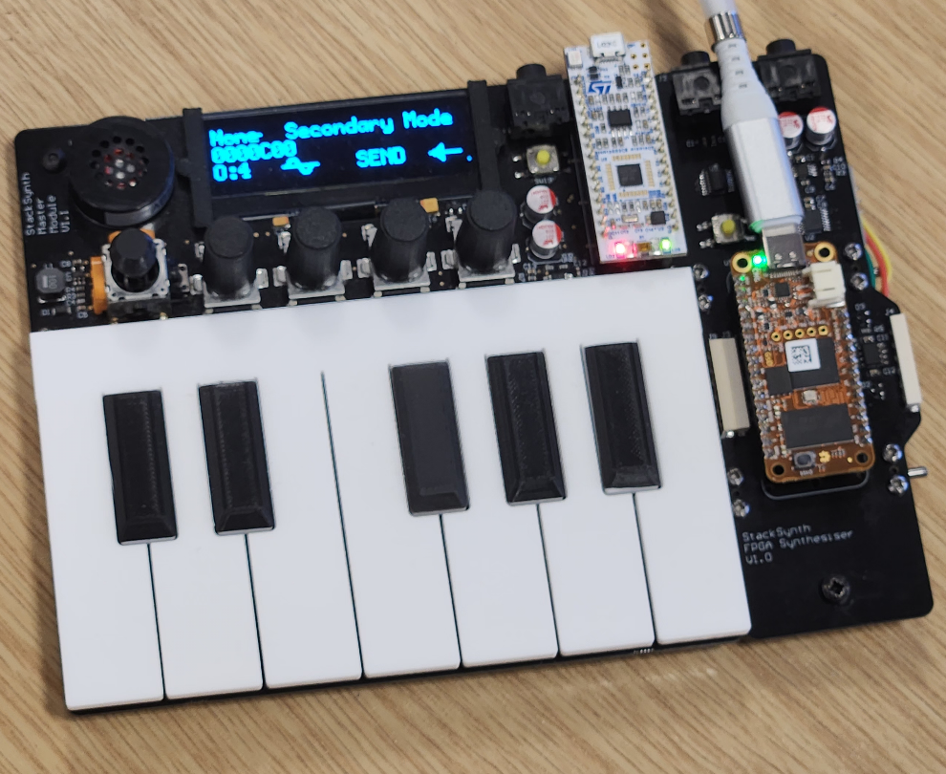
FPGA Accelerator for StackSynth
FPGA Accelerator for StackSynth
27/06/2023
Extending the audio capabilities of the 3rd Year Embedded Systems educational platform
EIE4: Aadi Desai
Project Supervisor: Dr Ed Stott
Notes:
Wear the Mic
Included an image of the StackSynth module and the FPGA Accelerator connected to it, power provided from a USB-C port

Slide 2
Presentation Structure
FPGA Accelerator for StackSynth
27/06/2023
Introduction
Project Architecture
Implementation in Use
Debugging Methods
Conclusions

Slide 3
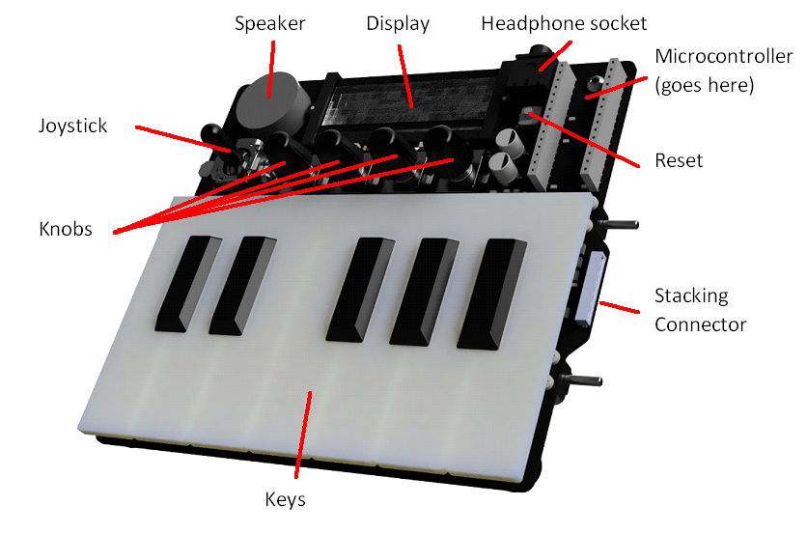
Introduction
FPGA Accelerator for StackSynth
27/06/2023
StackSynth: Nucleo L432KC Microcontroller
Matrix of keys, stacking inter-board connectors with presence detection and CANH/L pins
Aim: Increase audio performance & capabilities
More oscillators
Higher quality waveforms
Image from ELEC60013 Embedded Systems Coursework 2
Available: https://github.com/edstott/ES-synth-starter/blob/master/doc/synth.png
Notes:
Embedded Systems: teaches programming in resource constrained environments
Cw2 synth, strict timing requirements to prevent audible glitches
Key matrix, stacking connectors
In cw, task limited oscillators and effects
FPGA accelerator: more oscillators w/ higher quality waveforms (esp. sine)

Slide 4
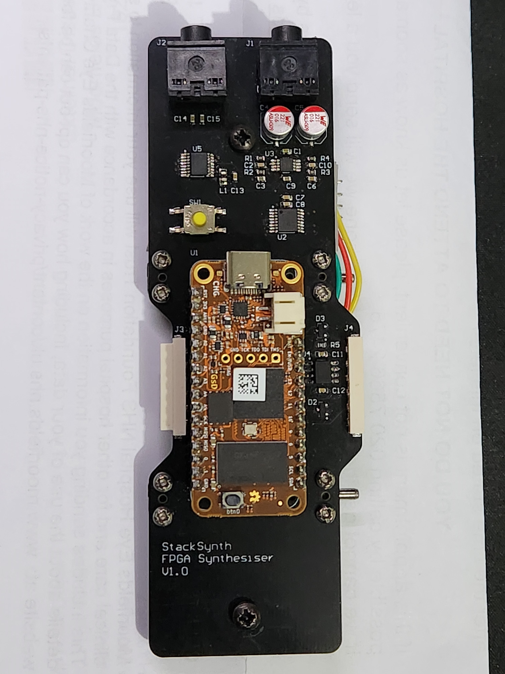
FPGA Accelerator Board
FPGA Accelerator for StackSynth
27/06/2023
Reset Button
Stacking inter-board connector
PCM1780 DAC
DS1881E Digital Potentiometer
100mW Stereo Amplifier
ATA6561 CAN Transceiver
OrangeCrab FPGA
Notes:
This is the Accelerator board, with: (List of items)

Slide 5
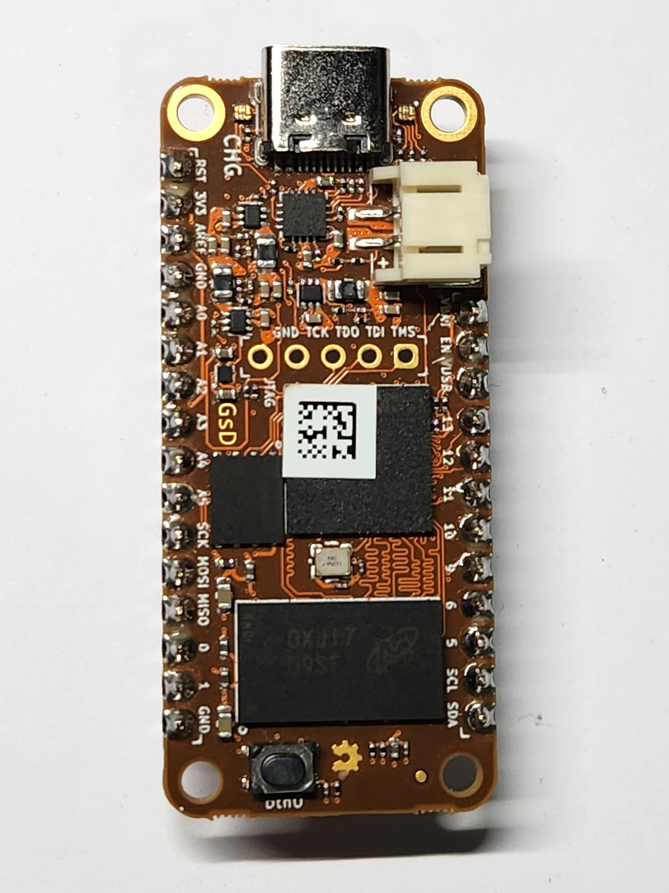
OrangeCrab FPGA
FPGA Accelerator for StackSynth
27/06/2023
Small size: 22.86mm x 50.8mm
Feather-compatible pin layout
Lattice Semiconductor ECP5-25F
1Gbit DDR3L Memory
USB-C Port
RGB LED
Button
Battery Connector
Notes:
OC benefits: size, compat FeatherWing, smaller accelerator board
Lattice ECP5-25F, a powerful, low power FPGA with 24,000 logic elements.
1Gb of DDR3L memory connected directly to the FPGA
USB-C port connected directly to FPGA pins, present as serial device, or other peripherals as needed
Many FPGA pins broken out as IO, used to connect hardware on accelerator board

Slide 6

LiteX Framework
FPGA Accelerator for StackSynth
27/06/2023
[1]
Reuse existing cores and IP
VexRiscV CPU
DDR3 RAM Controller
LiteScope Analyzer
Add custom modules
Using Migen: Domain Specific Language built on Python
SystemVerilog modules
self.dly = Signal(3) # Update saw after 2^3 = 8 cycles
self.saw = Signal(16)
self.sync += self.dly.eq(self.dly + 1)
self.sync += If(self.dly==0, self.saw.eq(self.saw+1))
self.comb += self.can_rx.eq(self.pads.rx)
self.comb += self.pads.tx.eq(self.can_tx)
self.specials += Instance("can",
i_i_clk = ClockSignal(),
i_i_rst_n = ~ResetSignal(),
# Other module inputs/outputs...
o_o_pulse = self.rcv_pulse
)
[1] Image from LiteX GitHub Readme, Available: https://github.com/enjoy-digital/litex
Notes:
Project uses LiteX, cores and IP, built on Migen, Python DSL
Used as it provides CPU and other IP, eg VexRiscV, USB Controller, DDR3 RAM Controller
VexRiscV is a 32-bit RISC-V CPU written in SpinalHDL and compiled to synthesizable Verilog and is the core that will run student-developed code.
In addition to provided cores, LiteX also allows you to create custom modules, either in Migen (example: signals, synchronous logic, combinatorial logic) or in SystemVerilog (example: Instance function, connecting signals).
Writing logic in Migen is mostly analogous to SystemVerilog, however throughout the project there were instances where an instance or object was not as LiteX expects it but as it is built on Python object dictionaries, there is often no error, and the design synthesizes into unexpected logic.

Slide 7
Project Contributions
SystemVerilog modules and LiteX wrapper modules:
CAN Receiver
Sample Generator (oscillators, phase → amplitude converters)
DAC Driver
LiteX project combining modules into a complete design
Software support for hardware
Libraries for interfacing with registers following hardware requirements
E.g. Set oscillator index before updating selected waveform or target frequency
Program demonstrating basic uses of modules
Decoding CAN frames, checking for interrupts, controlling oscillators

Slide 8
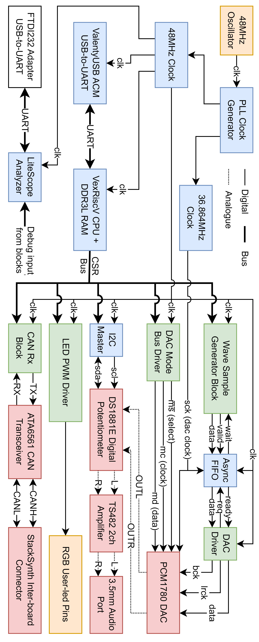
Project Architecture
FPGA Accelerator for StackSynth
27/06/2023
Orange: OrangeCrab Hardware
Red: StackSynth Accelerator Board
Blue: LiteX Provided IP / Cores
Green: Custom Modules / Cores
Notes:
This is an overview of the project architecture, with colours for the different categories of blocks.
(COLOURS)
Not provided as part of the project hardware but also included in this image is a UART-to-USB converter, used for communicating with the LiteScope Analyzer as it requires a separate serial port from the main serial console.
(LINE TYPES)
The following slides will detail interesting areas of the expected data flow, as in the demonstration software in the project repository. This starts at the inter-board connector, CAN transceiver and receiver, followed by software running on the CPU which reads the received CAN frame and drives the wave sample generator.
Generated frames are transferred from the system clock domain to the DAC clock domain via an asynchronous first-in first-out buffer and converted to serial samples by the DAC driver module.
The analogue output from the DAC is then attenuated by the digital potentiometer and finally an amplifier increases the power output so low-impedance devices can be driven directly.

Slide 9
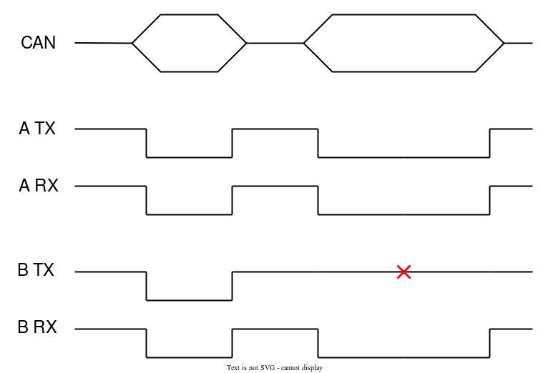
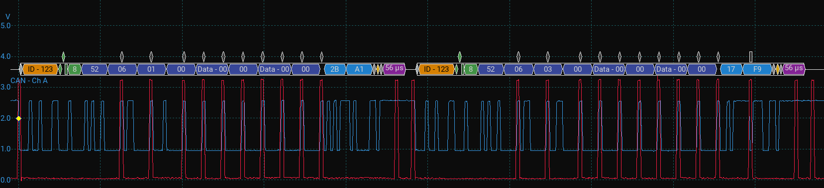
CAN Receiver
FPGA Accelerator for StackSynth
27/06/2023
ATA6551: microcontroller level logic ←→ CANH/CANL differential signalling
Calculate stuff bits
PicoScope to verify
Check valid frame
Recessive
State
Dominant
State
VCC/1
GND/0
Notes:
CAN Transceiver, then sampled and added to shift register
CAN non-return-to-zero, sync on falling edge, recessive -> dominant
Prevent desync, use sync transitions, if 5 bits, insert opposite stuff bit (but not to shift reg)
Old: check last 5 bits of shift reg, locks when stuff bit detevted as it is not shifted in, ignores stuff bits in counting
New: counter, reset when input flips or stuff bit detected
Image: verifying stuff bit and ack
CAN Rx checks frame ID using filter mask and ID (controllable)
Valid frame: drive dominant state to ACK, store ID/Data, generate interrupt

Slide 10
Demo Program
FPGA Accelerator for StackSynth
27/06/2023
Checks for software interrupts, prints received CAN frame information
Individual functions for controlling modules
CAN Rx filter ID/mask, oscillator settings, amplifier volume
Function to read CAN frames and play audio
Future work: Port FreeRTOS kernel, allow tasks with initiation intervals and priorities to be handled by the FreeRTOS scheduler
Requires timers and hardware interrupts, logic is in place, software to set up interrupt handlers remaining

Slide 11
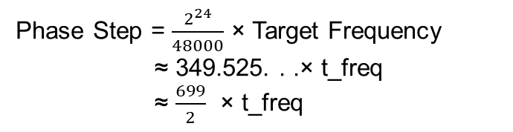
Numerically Controlled Oscillator
FPGA Accelerator for StackSynth
27/06/2023
Phase accumulator + phase to amplitude converter
Register incremented by step size each clock cycle, overflows at the specified frequency
24-bit accumulator
Output: 16-bit phase
Error in frequency averaged out over time
Phase Step = $\frac{2^{24}}{48000}$ × Target Frequency
≈ 349.525. . .× t_freq
≈ $\frac{699}{2}$ × t_freq
logic [23:0] int_p_step; always_comb int_p_step = (24'd699 * t_freq); // 699 approx. (2^24 / 48000) * 2 logic [15:0] p_step; always_ff @(posedge i_clk48) p_step <= {1'b0, int_p_step[23:9]}; // Shift step right and truncate to 16 bits
Notes:
NCO = phase accumulator + phase -> amplitude converter
Acc can be larger, higher precision of phase step, use truncated output
Errors in phase output avg over time, less noticeable than error in frequency
Acc is 24 bit, phase output is top 16 bit
Equation: target frequency to phase step
SystemVerilog: same, 699/2 for better precision

Slide 12
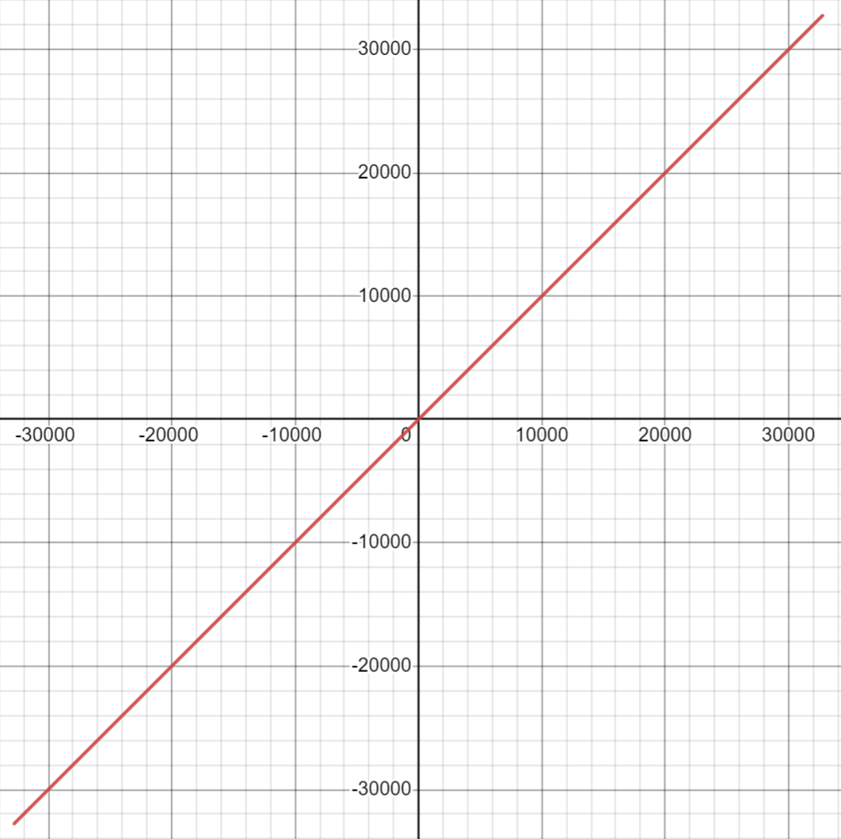
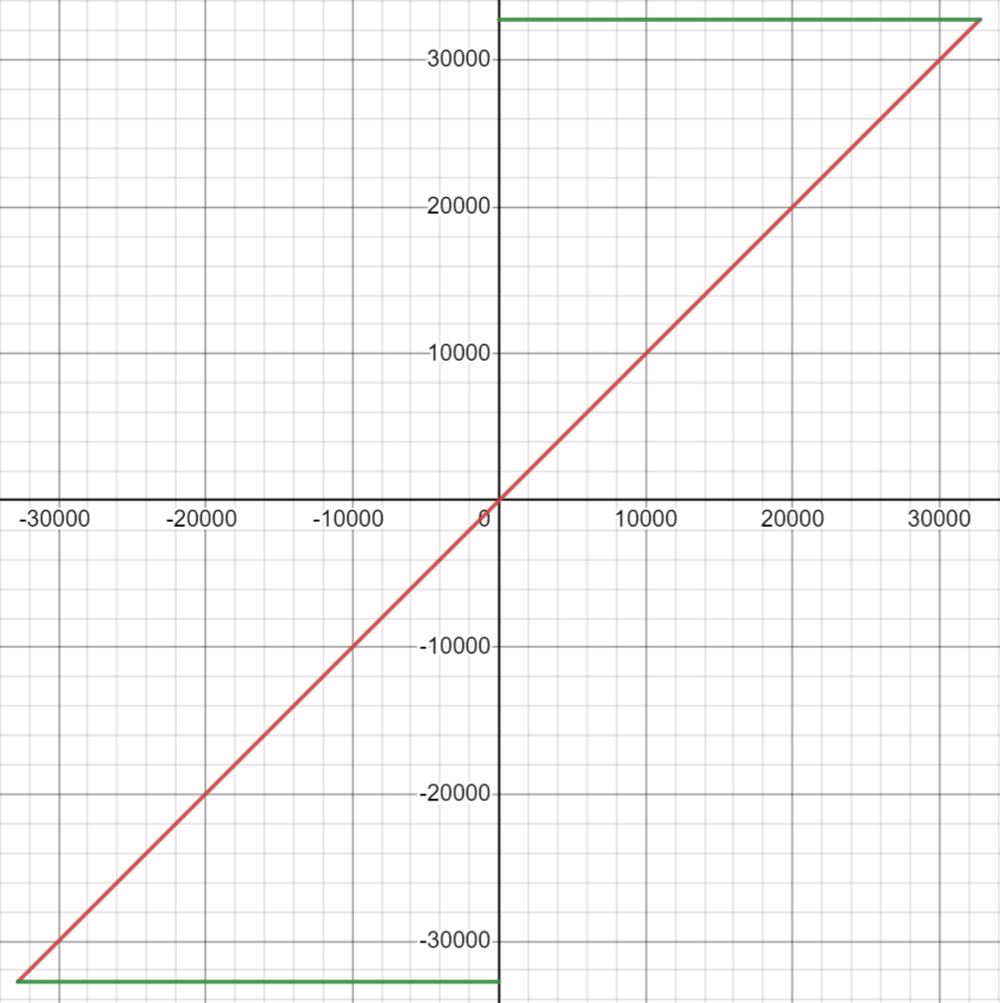
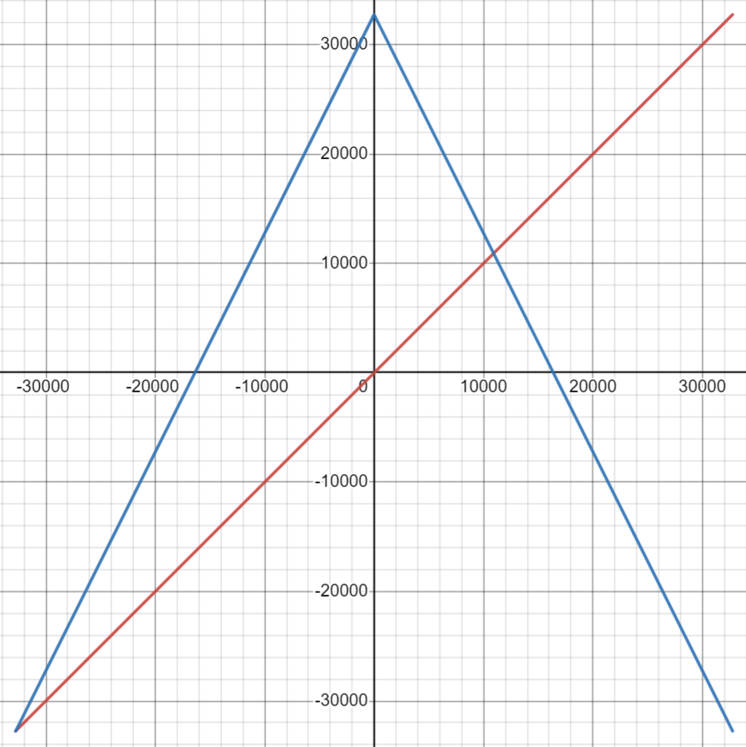
Numerically Controlled Oscillator
FPGA Accelerator for StackSynth
27/06/2023
Phase accumulator + phase to amplitude converter
Register incremented by step size each clock cycle, overflows at the specified frequency
24-bit accumulator
Output: 16-bit phase
Error in frequency averaged out over time
Phase Step = $\frac{2^{24}}{48000}$ × Target Frequency
≈ 349.525. . .× t_freq
≈ $\frac{699}{2}$ × t_freq
logic [23:0] int_p_step; always_comb int_p_step = (24'd699 * t_freq); // 699 approx. (2^24 / 48000) * 2 logic [15:0] p_step; always_ff @(posedge i_clk48) p_step <= {1'b0, int_p_step[23:9]}; // Shift step right and truncate to 16 bits
Notes:
Next: phase to amplitude
As in cw, available: sawtooth, square, triangle, sine
Direct mapping with sawtooth, square and triangle waves
Sawtooth has no change, a 50% square wave can be made from the phase sign or MSB and a triangle wave by taking the magnitude of the signed phase and doubling.

Slide 13
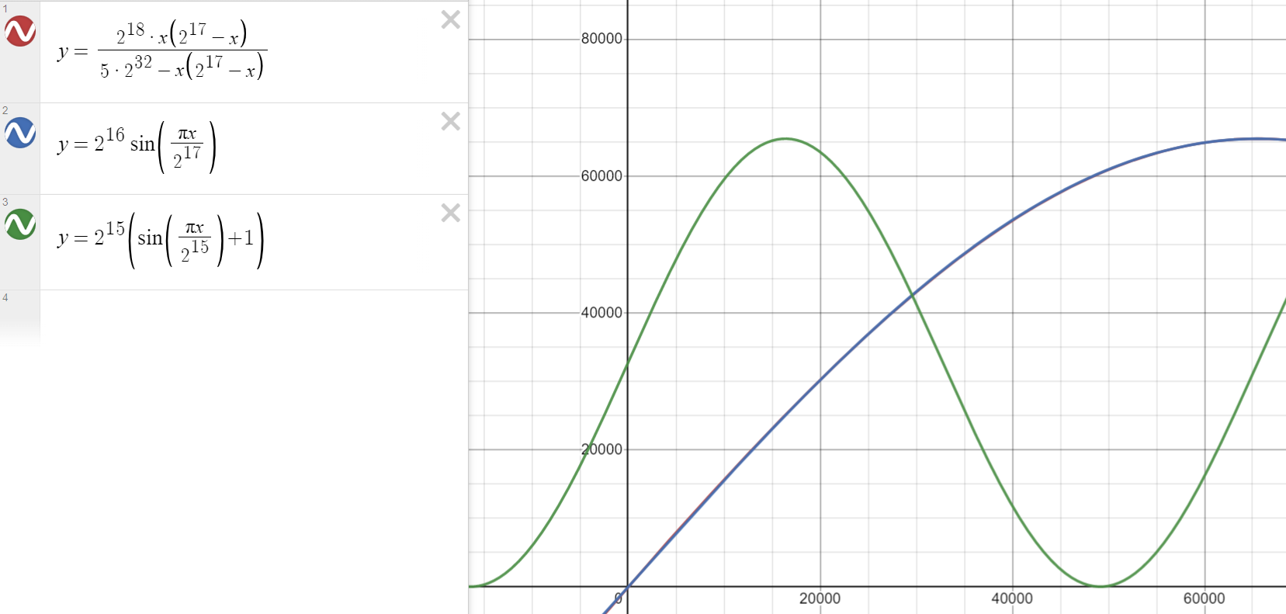
Phase → Sine Amplitude Conversion
FPGA Accelerator for StackSynth
27/06/2023
Scaled version of the Bhaskara I approximation^{[2]}
Adjusted to have input and output ranges of 0 – 65535
Forms a quarter sine wave
Large divide (~35-bits) requires lots of logic elements, and does not fit on the ECP5-25F
Image: Screenshot of Desmos Graphing Calculator, Available: https://www.desmos.com/calculator
[2]: Bhaskara I approximation mentioned in Approximating the Sine Function, Available: http://datagenetics.com/blog/july12019/index.html
Notes:
Sine: initially test polynomial, less code needed
Blue line: reference sine, scaled to 16 bit input and output quarter sine wave
Red line: entirely covered by blue, approximation is scaled Bhaskara I approx.
Converted to full wave with wrapper: rev / inv IO
Synthesis: large comb logic due to divide, does not fit in ECP5-25F

Slide 14
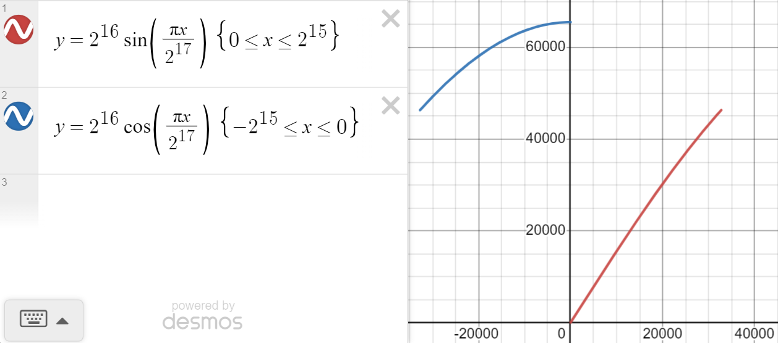
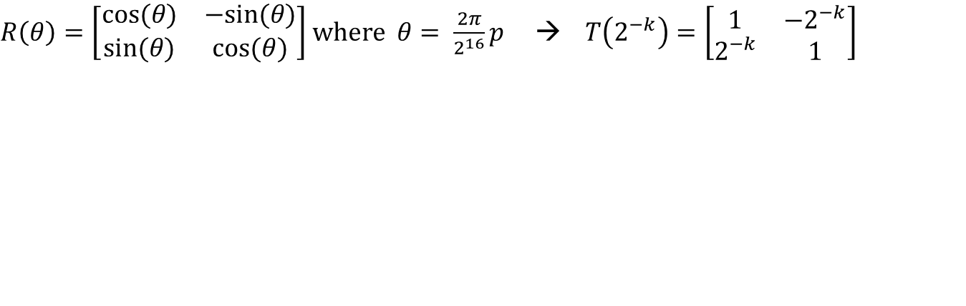
CORDIC
FPGA Accelerator for StackSynth
27/06/2023
COordinate Rotation DIgital Computer
$R\left(θ\right)=\left[\begin{matrix}cos⁡(θ) & −sin⁡(θ) \\ sin⁡(θ) & cos⁡(θ)\end{matrix}\right]$ where $θ= \frac{2π}{2^{16}}p$ → $T\left(2^{−k}\right)=\left[\begin{matrix}1 & −2^{−k} \\ 2^{−k} & 1\end{matrix}\right]$
Image: CORDIC Rotation Vectors, ZipCPU
Available: https://zipcpu.com/dsp/2017/08/30/cordic.html
Image: Screenshot of Desmos Graphing Calculator, Available: https://www.desmos.com/calculator
Notes:
Instead: CORDIC, rotate input vector incrementally
R rotation matrix,, not ideal for FPGA
T approximation where cosine replaced with 1, impl only needs right shift and addition
Gives angles shown in image, results in increase in magnitude
Magnitude scales with number of stages, 19 are used, precalc and compensate by reducing initial vector
Max rotation: +-45 degrees, need 0 – 90, use 0-45 sine, -45-0 cosine shown in graph

Slide 15
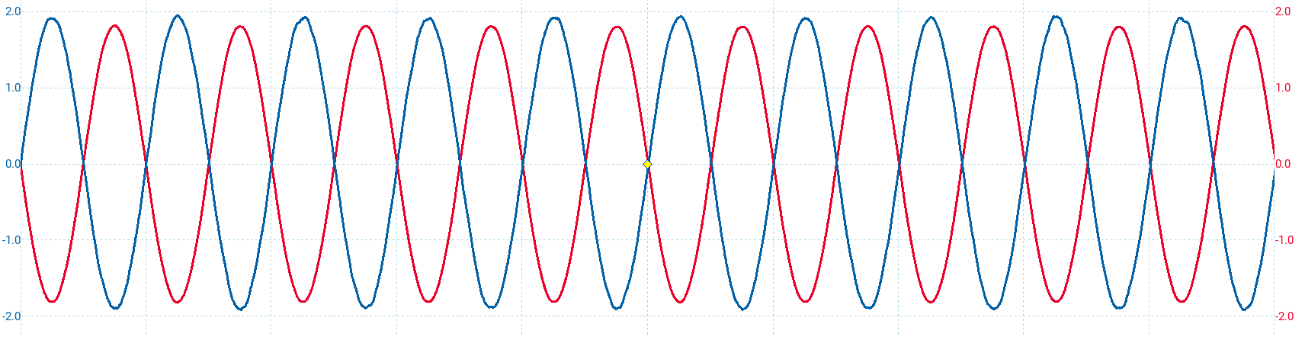
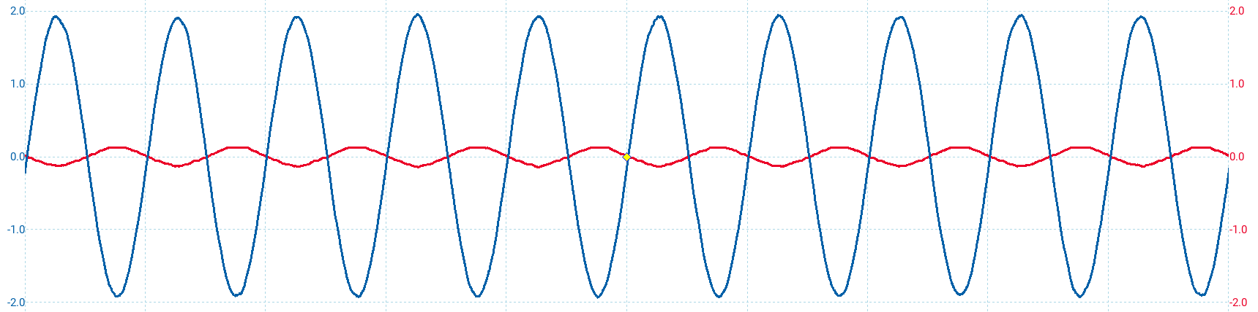
Amplitude Accumulator, Volume Control
FPGA Accelerator for StackSynth
27/06/2023
Samples sign extended from 16-bit to 24-bit
Prevent overflows when adding samples
always_comb s_long[0] = {{8{samples[0][15]}}, samples[0]}; // Add up sign extended samples
for (genvar i = 1; i < 64; i++) begin always_comb s_long[i] = s_long[i-1] + {{8{samples[i][15]}}, samples[i]}; end
Notes:
Sign extend samples and sum, prevent overflows = glitches in waveform
Sample shift right, prevent maximum value overflowing in 16-bit output
24-bit output could be used with no shifting, volume scale with number of active oscillators
Screenshots from PicoScope, DAC blue, AMP red, top full volume, bottom 16dB attenuation using digital potentiometer

Slide 16
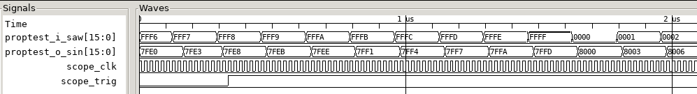
LiteScope Analyzer
FPGA Accelerator for StackSynth
27/06/2023
self.submodules.analyzer = LiteScopeAnalyzer(
[ self.proptest.i_saw,
self.proptest.o_sin],
depth = 20480,
clock_domain = "sys",
samplerate = 48e6,
csr_csv = "analyzer.csv")
Notes:
One method used for debugging the SystemVerilog modules is the LiteScope Analyzer, which was present in the lower left corner of the system architecture diagram.
The python on the right shows how the module is included in a design.
A list of signals to trace is passed in, along with the number of samples to store and the clock domain to sample within.
At runtime, the signal to trigger with can be selected, including the value or a rising or falling edge.
The screenshot shows GTKWave when testing the propagation delay of the sawtooth to sine conversion using the cordic module.

Slide 17
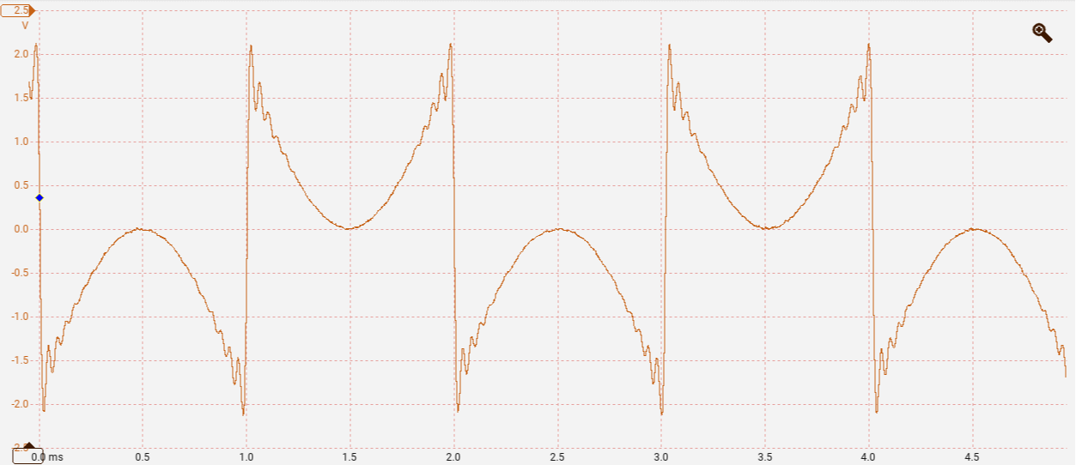
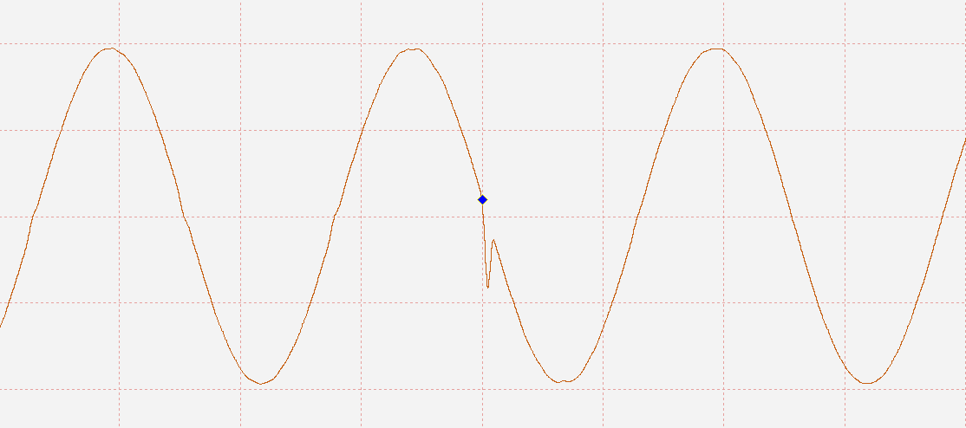
PicoScope
FPGA Accelerator for StackSynth
27/06/2023
Screenshots from PicoScope 7
Samples treated as signed causing 2¹⁵ offset in output waveform
Output of CORDIC not registered, glitches in output value are audible as clicks
Notes:
The PicoScope was used to view the output waveform and aided in the debugging of two issues shown here.
The first is when the output samples were treated as unsigned values rather than signed, resulting in the sine wave being discontinuous and shifted by half the amplitude range.
The second is when the output of the cordic module was not registered and resulted in unstable output values. This caused glitches in the output audio, visible as a glitch in the screenshot.

Slide 18
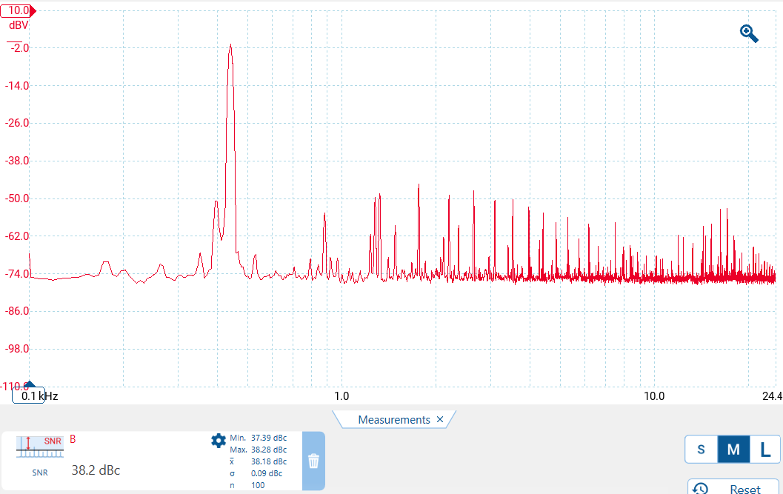
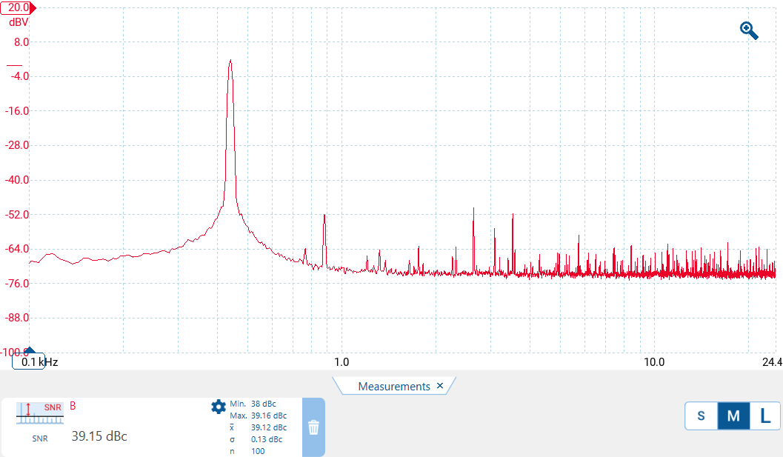
Evaluation against StackSynth
FPGA Accelerator for StackSynth
27/06/2023
Signal-to-Noise Ratio
StackSynth Module OrangeCrab FPGA Accelerator
Notes:
These screenshots show the measured Signal-to-Noise Ratios of the original StackSynth module on the left and the FPGA Accelerator board on the right.
The measurement using the PicoScope shows an improvement of around 1 decibel.

Slide 19
Evaluation against StackSynth
FPGA Accelerator for StackSynth
27/06/2023
Signal-to-Noise Ratio
Ability to use many more oscillators
Embedded Systems coursework examples often had 1-5 oscillators, sometimes optimised by generating samples in lower-priority task
64 in project, using almost all available logic elements
Project is extendable with more custom modules, limited by available FPGA resources
Equalisation and filters, applied sequentially on samples in-between the wave sample generator and Asynchronous FIFO buffer

Slide 20
Conclusions
FPGA Accelerator for StackSynth
27/06/2023
Usable extension to the existing coursework
Many more oscillators available
Software libraries similar to ES_CAN from coursework
Learnings
Digital design in SystemVerilog
LiteX & Migen
Future Work
Other waveforms
Effects on samples, equalisation and filters
Hardware interrupt configuration in software
FreeRTOS Kernel & Scheduler
Notes:
Many more oscillators available: can connect multiple StackSynth modules together and still produce the expected audio
Learned about digital design using SystemVerilog and the potential issues when crossing clock domains and transferring data between modules is necessary, as well as the LiteX framework which may be useful when working with open-source FPGA toolchains in the future.
Future work for this project includes the ability to generate other waveforms than the 4 specified, generate effects on the stream of samples such as equalisation and filter taps, the addition of software to configure hardware interrupts and finally porting the FreeRTOS kernel and scheduler to bring the software experience inline with the existing coursework.

